Slide 1



8
Influence
factors
Of
Movie
box office
Team Name:
AWALONG
Team Members:
DI WU,YI SHEN,ZELONG YAN,QILING CHEN,HAN TONG

Slide 2
ONTENTs
1
Abstract
2
Problem Statement
3
Implementation
4
Results Display
5
Conclusions
6
Limitations and
future work

Slide 3
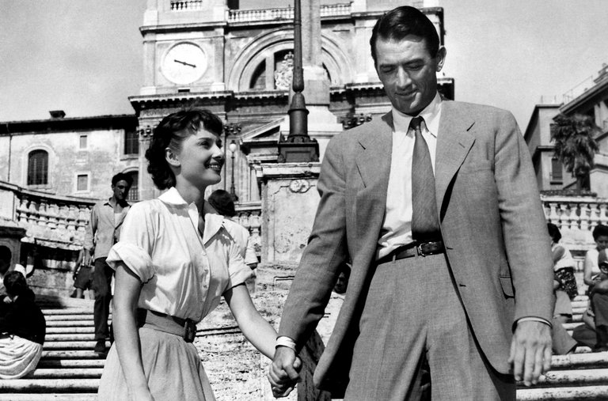
PART ONE
Abstract

Slide 4

abstract
The problem we are trying to solve is to study factors affecting the box-office. The mainly processes contain data collection , cleaning , analysis and visualization . And we adopt certain approaches to solve the problem, such as linear regression , the neural network and support vector regression . We obtained the most influenced factors and tried to predict future box office.

Slide 5

Problem Statement
PART two

Slide 6
introduction
Watching films , as a daily activity, has become a symbol of the trend of culture.More and more filmmakers have made the industry more prosperous.With the increasing amount of movies,the competition of film and television industry is also increasing.And the box office that played a decisive role also became the target that the filmmakers are pursuing.Therefore,it is crucial to understand the influence factors of the box office and the market preference.The main reason why we choose this topic is that it is related to life.In addition,the project is highly researchable and flexible.Through research,we could find out the decisive factors that influence the box office and the intrinsic statistical relationship between factors and box office.Moreover,we could also predict the box office of future films based on the models.

Slide 7

Part three
Implementation

Slide 8




Project process
Data collection
Data Cleaning
Data Analysis
Data Visualization

Slide 9
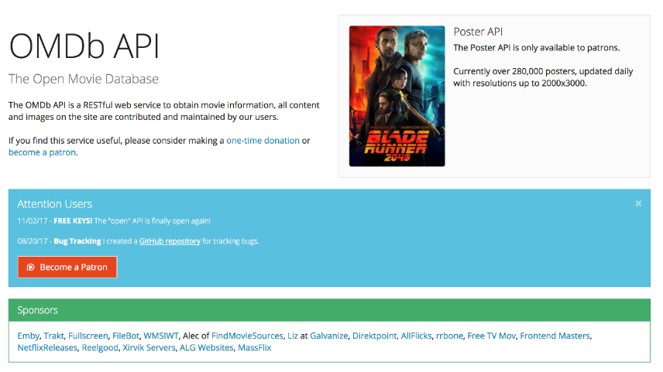
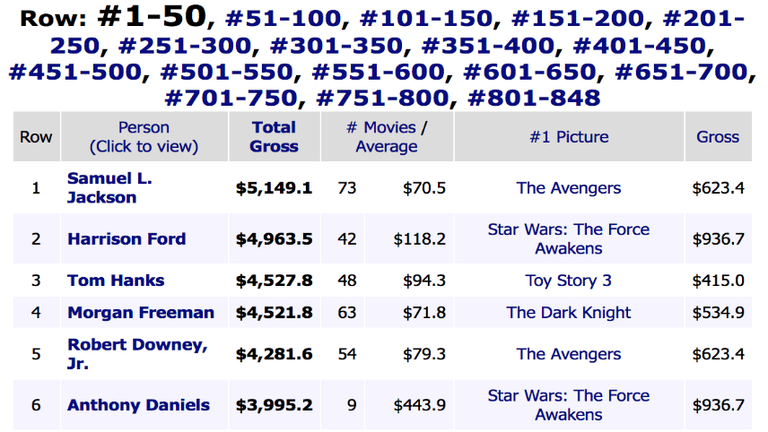
Data collection
🌏
🎃
🏰
Mojo Box office
OMDB API
IMDB
Source: http://www.omdbapi.com
Source: http://www.boxofficemojo.com

Slide 10






Collecting process
Multi-threading
Scraping and Querying
I/O intensive tasks
Store in CSV

Slide 11
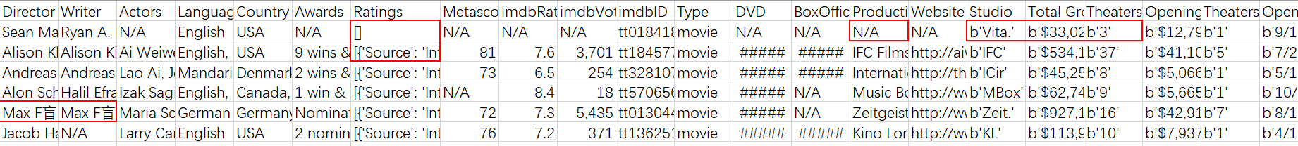
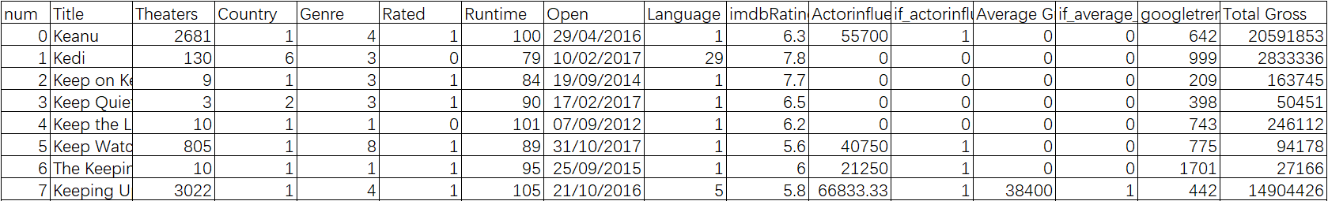

Data cleaning——step 1
Troubles:
Large amount of data and more parameters
The parameter configuration is not consistent
Vacancy value need to be filled

Slide 12
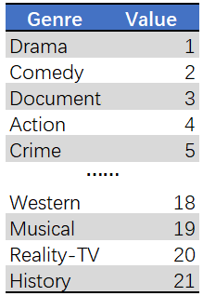
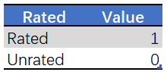
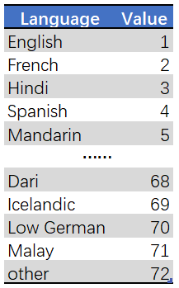
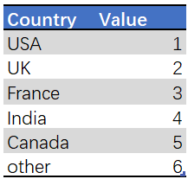
Data cleaning——step 2
Fill in the vacancy value, and do
related processing for the part
of the null value
Standardized the classification
fields

Slide 13
Final data sheet
Field | Illustration
Title | Title of movies
Theaters | Released theaters
Country | Country of film production
Genre | Genre of movie
Rated | Whether limited or not
Runtime | Time of movie
Language | Language of movie
imdbRating | Score in IMDB
Actorinfluenceaverage | Average box office of actor
Average Gross for each movie | Average gross of movie
googletrends | Movie title and trailer for the former month combined in Googletrend
last year_totalgross | Total gross in last year
genre_gross | Gross of genre
the corresponding period | Number of corresponding period
Total Gross | Total gross

Slide 14
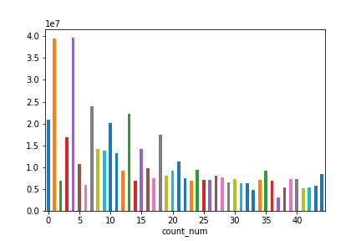
Same period films
The relathionship between Total Gross and the number of films released in the same period.
The fewer films released during the same period, box office will be better.
Possibable Reason:
Similar films grab market share
Distributors pay more attention on improving the quantity of movie (business value) rather than movie quality

Slide 15
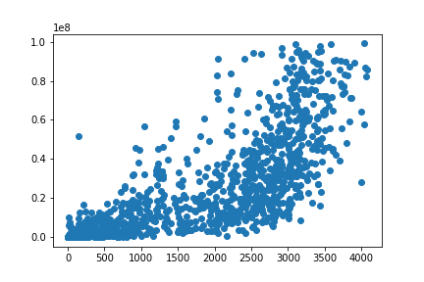
theater
Relathionship between Total Gross and number of Theaters
There is a positive correlation between the box office and the number of theaters.
Films with more theaters are also better at the box office.

Slide 16
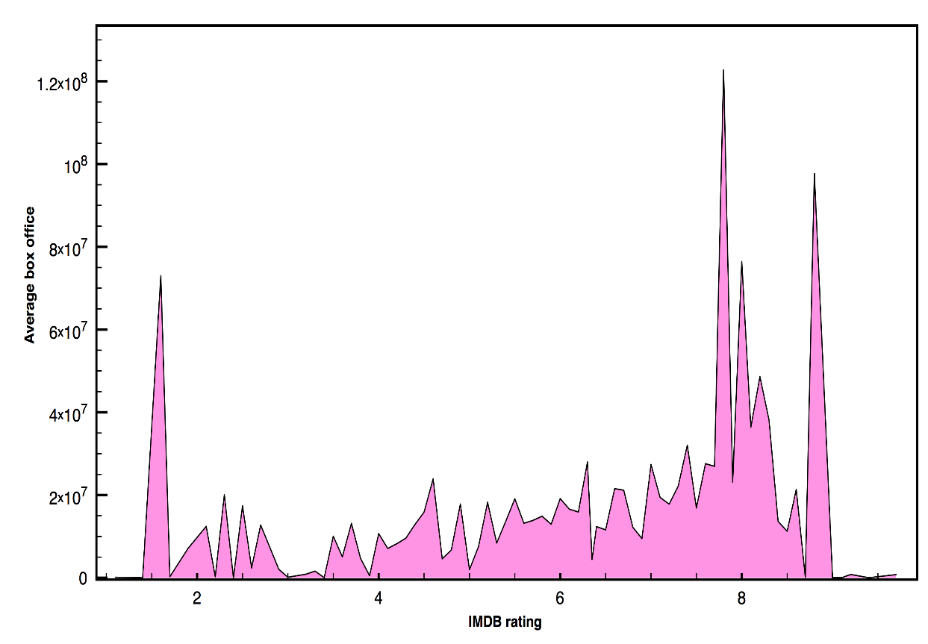
Imdb rate
Relathionship between average box office and IMDB rating
There are three peaks in the chart(around 1, 8 and 9)
Most IMDB rating is around 8
Not many films with particularly high rating.
Possible reasons:
The higher rating movie has the better box office
Films with too high rating because of its high literary and artistic quality can't generate social resonance
The number of low-rating movies are small, and they have high box

Slide 17
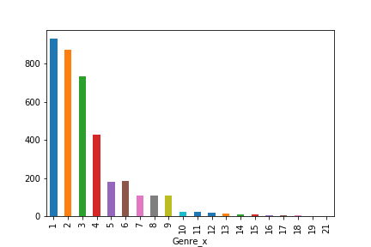
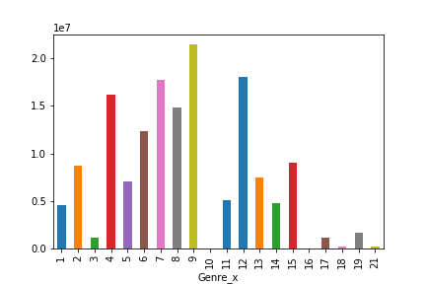
genre
The figure 1 shows the distribution of movie Genre
Both of the Drama and Comedy are numerous
The most popular movie type is Drama
There are also lots of Documentary
The Action is the fourth type
Other types are little
However:
The figure 2 illustrates the relationship between Total Gross and movie Genre
The total gross of Advanture is the highest
Animation = Mystery
The fouth is Action
Despite Drama and Documentary have large numbers, their total grosses are low
Mystery, Fantasy, Sci-Fi and Romance are much little, but the total gross of them represent the opposite results

Slide 18

Data visualization

Slide 19

Results Display
PART four

Slide 20
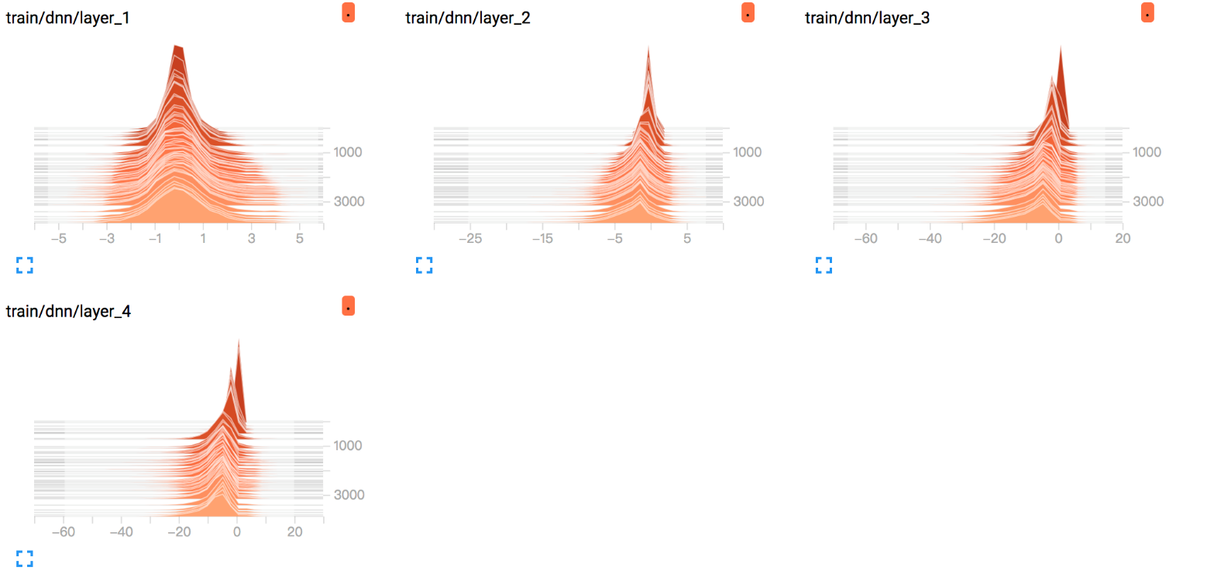

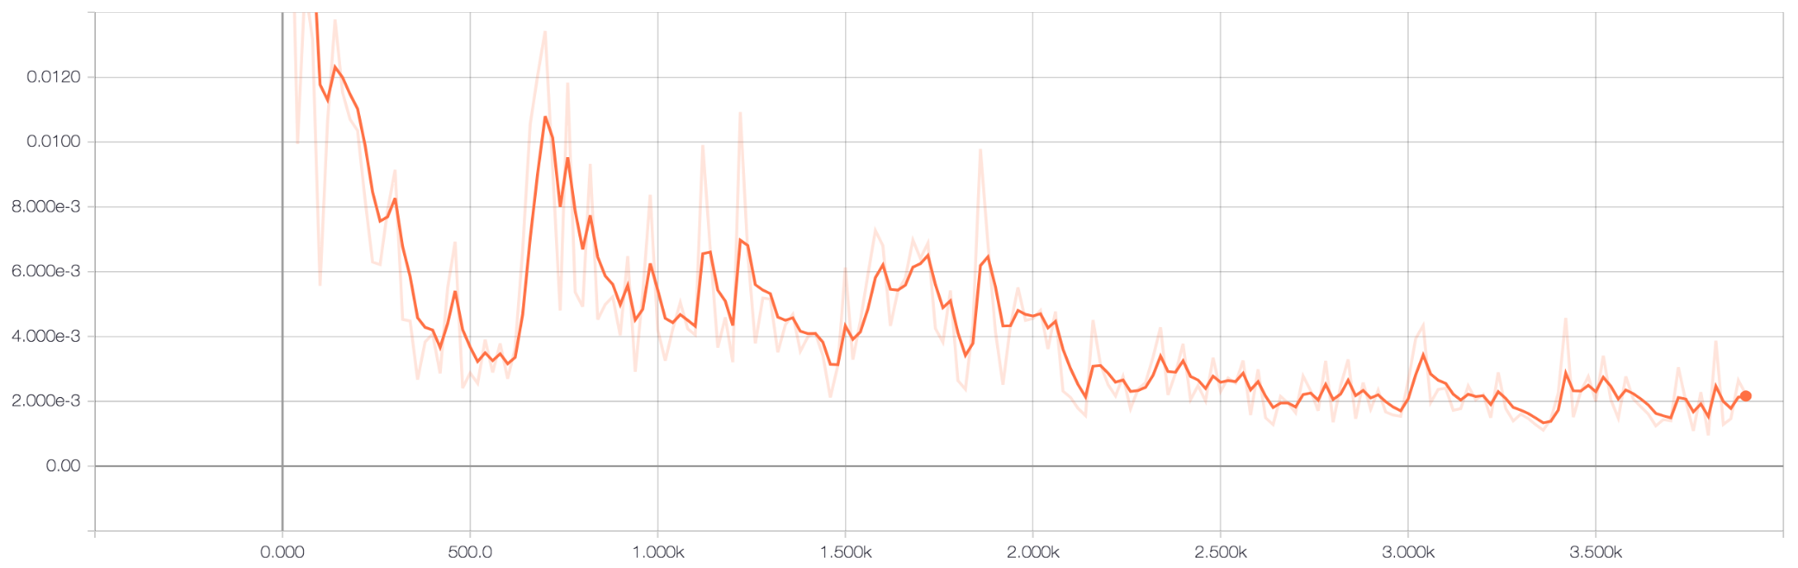
DEEP neural network
Four hidden layers
Rectifier neural units
Adam optimizer
Mean squared error
Histograms for four layers
Dropout in second and third layers

Slide 21
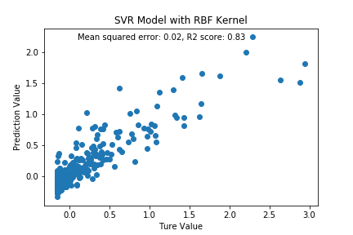
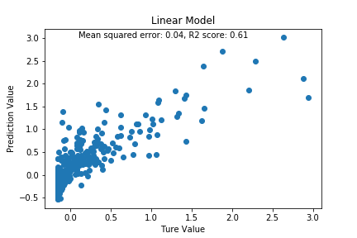
Other approaches

Slide 22
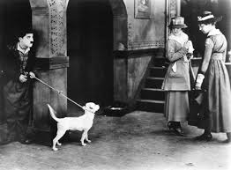
5
Part five
Conclusions

Slide 23


Conclusions
In this coursework , we fellow the whole pipeline of data science : data collection, data cleaning, data analysis and data visualization. And we apply this to our topic : the studies of the influence factors of movie box office. We have got certain results, and prediction was congratulated acceptable. However the whole accuracy is still need to be improved by adding more delicate features. The results we have found could be adopt to analyze the influence factors of movie box office.

Slide 24

Limitations and future work
6
PART six

Slide 25
Limitations
Features could be improved by add more informative sub features
For example: ‘Search trends’= ‘google trends’+’twitter heats’+’youtube search’
Feature engineering need more advanced techniques
For example: null value, category variables, scaling techniques

Slide 26

Thank YOU

